Slide 1
Final Project
Feature Engineering

Slide 2
Agenda
About data
Data Cleaning
Statistics about data
Feature selection
Feature extraction
Data scaling

Slide 3
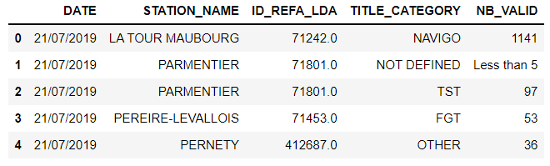
About data
This dataset presents the number of passenger validations per day per station name and per ticket on the rail network.
DATE : Date of validation.
STATION_NAME : validation's station name.
ID_REFA_LDA : Stop identifier in the STIF reference database.
TITLE_CATEGORY : Transport tickets( IMAGINE R,NAVIGO, AMETHYSTE, FGT , NOT DEFINED)
NB_VALID : The number of passenger validations

Slide 4
IMAGINE R: combines the annual Imagine R School and Imagine R Student packages reserved for pupils, apprentices and students which allows to travel at will all year round and in all of Ile-de-France.
NAVIGO : includes the Navigo Annuel, Navigo Mois and Navigo Semaine packages.
AMETHYSTE : includes the Amethyst packages: package reserved for seniors or disabled under conditions of means or status, and residing in the Île-de-France region.
TST : groups together weekly and monthly reduced fare packages granted to beneficiaries of the Transportation Solidarity Reduction program, to travel within the selected zones in all the modes of transport in the Île-de-France region.
FGT : accounts for the Navigo Gratuité Transport Packages, a package that allows certain receiving social assistance to travel free of charge throughout the Paris Region.
OTHER TITLE : accounts for special packages.
NON DEFINED : records validations for which the type of ticket is not defined (anomalies)
NB_VALID : Number of validations. 1 validation = 1 person
ID REFA LDA : -1 means that the data is not defined

Slide 5
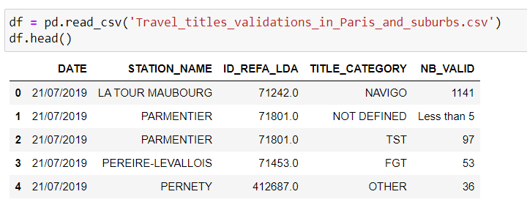
Reading Dataset

Slide 6
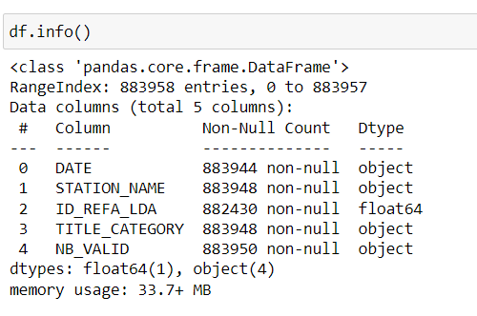
Exploring data
Info about data

Slide 7
Data cleaning
Check Missing Data
- Check NaN Values Count.
- Fill Missing data strategy :
- For Numerical Data :
* Mean * Median * Mode or Most frequent
- For Categorical Data :
* Mode or Most frequent
-Fill Missing data with Sklearn Imputer
- SimpleImputer
* Mean * Median * Mode or Most frequent
Drop unnecessary Data

Slide 8
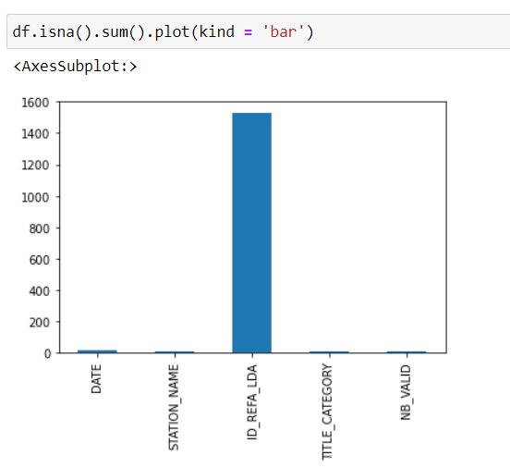
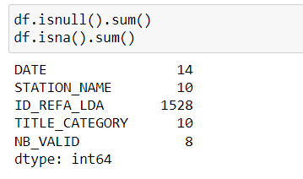
Check Missing Data
We observe that most missing data in ID_REFA_LDA column

Slide 9
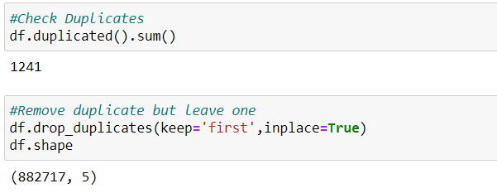
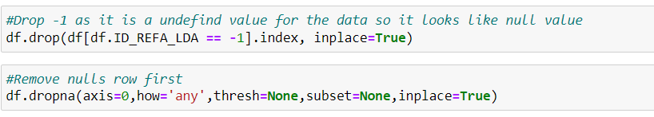
Check dupicates and remove it
Drop -1 as it is a undefined value for the data so it looks like null value and remove rows on nulls

Slide 10

Remove ID_REFA_LDA Column
We remove this column cause ID don’t affect target of data

Slide 11
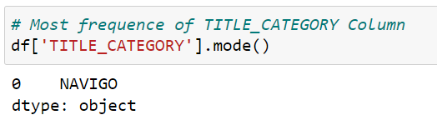
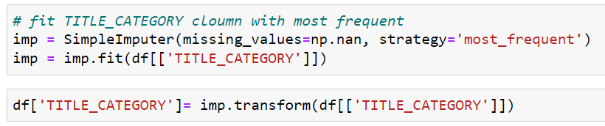
Fill missing data in TITLE_CATEGORY column with most frequent using SimpleImputer

Slide 12
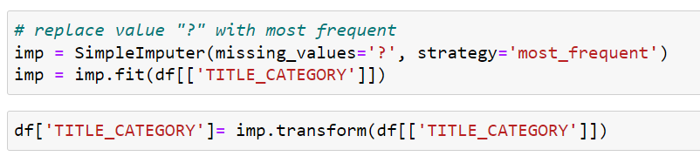
replace value "?“ in TITLE_CATEGORY column with most frequent
We observe that there is “ less than 5” value in NB_VALID column so we replace it with constant value that equal “3”

Slide 13
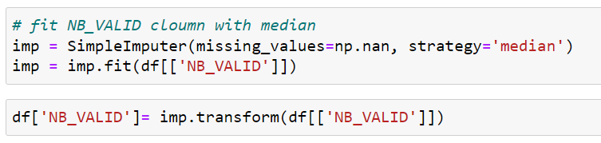
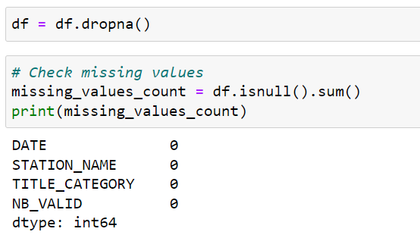
Fill missing data in NB_VALID column with median
Check missing value after cleaning

Slide 14
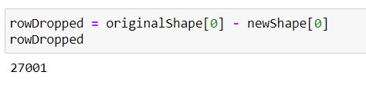
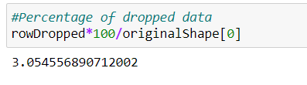
Num of dropped data
Percentage of dropped data

Slide 15
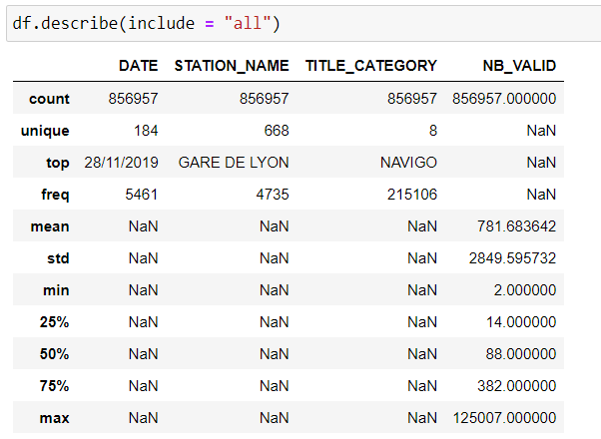
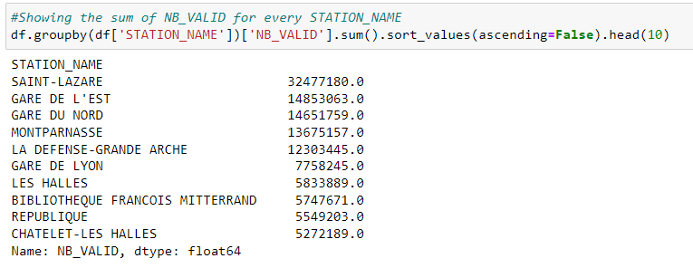
Statistics about data
Some statistics
Showing the sum of NB_VALID for every STATION_NAME

Slide 16
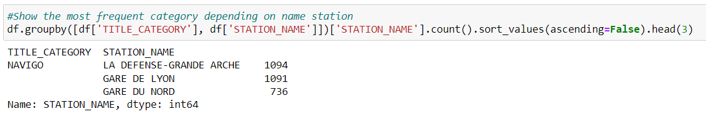
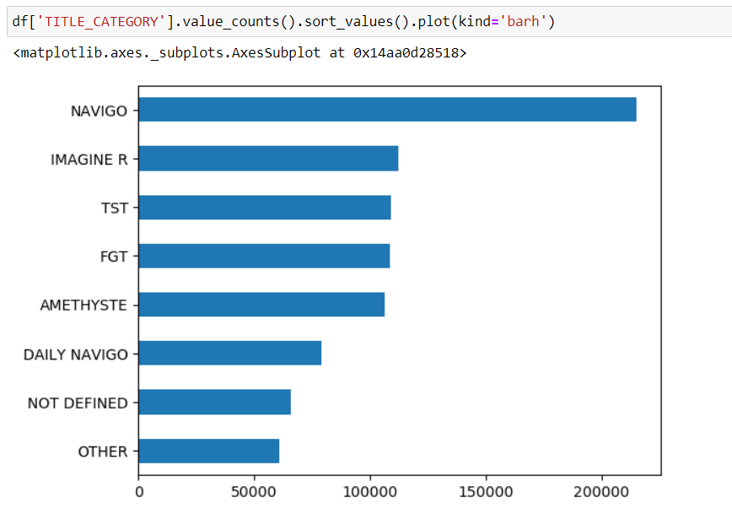
Showing the most frequent category depending on name station
Value counts of TITLE_CATEGORY column

Slide 17
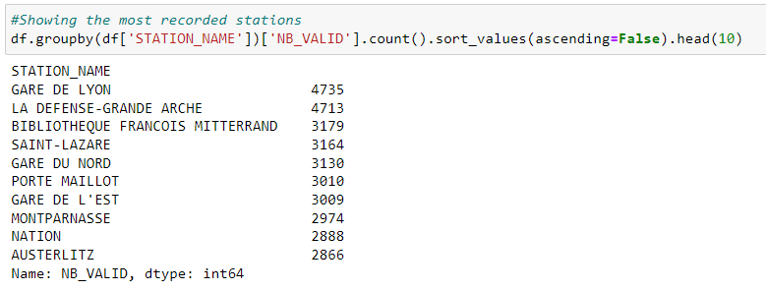
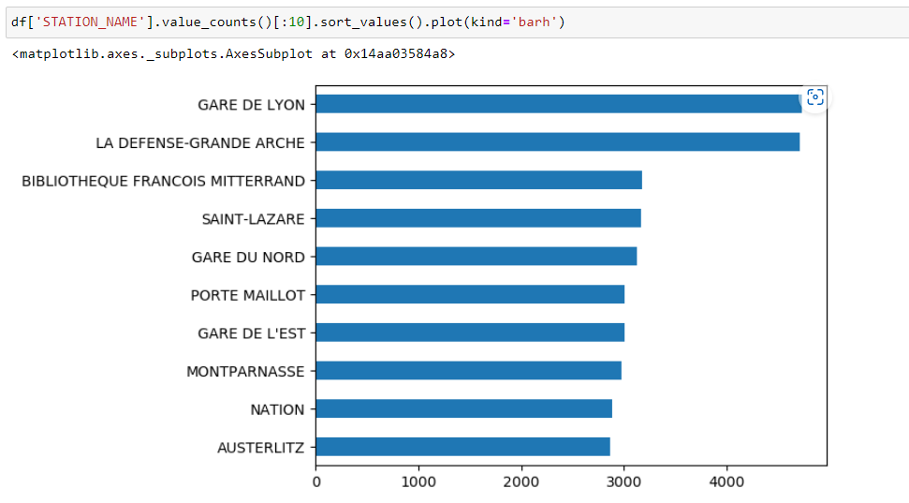
Showing the most recorded stations
Value counts of STATION_NAME column

Slide 18
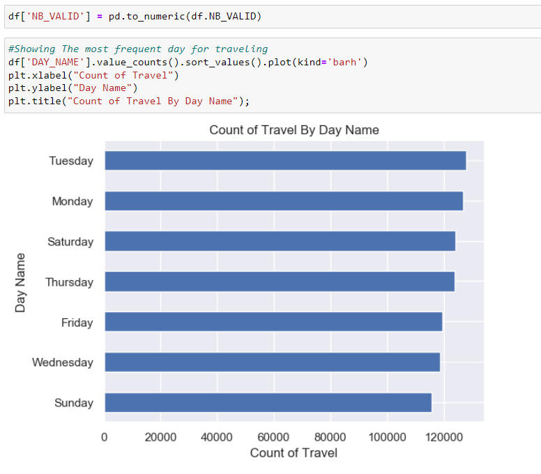
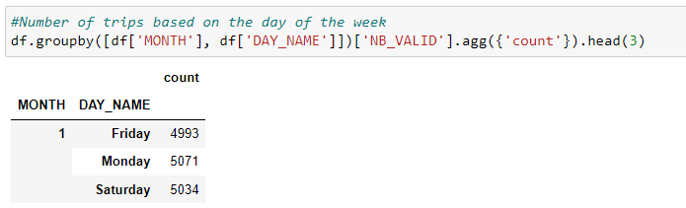
Exploratory Data Analysis
Showing The most frequent day for traveling
Number of trips based on the day of the week

Slide 19
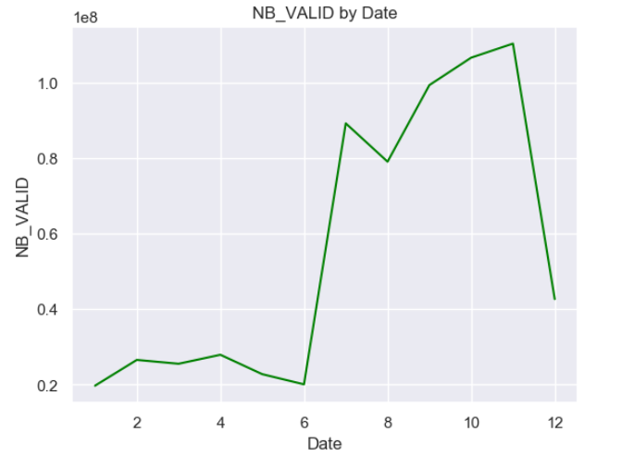
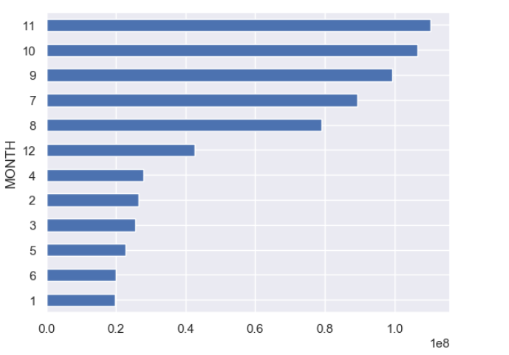
Showing the number of NB_VALID for every month
Showing the most frequent month

Slide 20
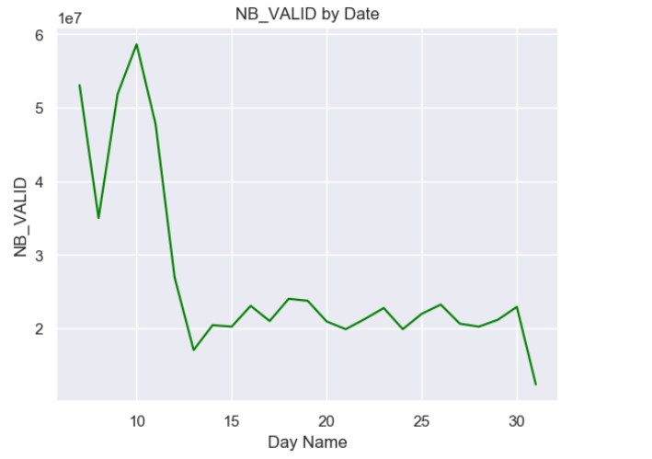
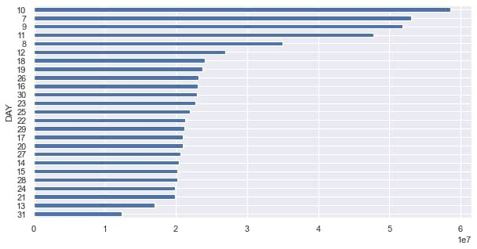
Showing days with a lot of trips
Counts of travel by day name

Slide 21
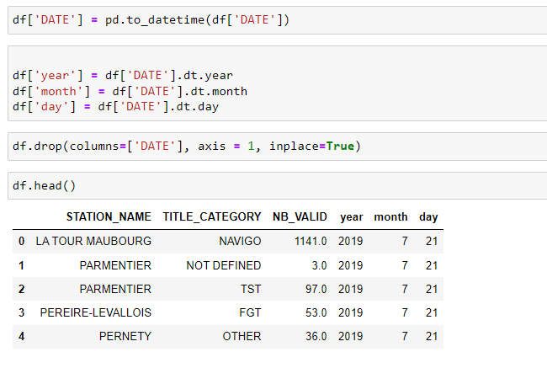
Feature Extraction
Extraction of (month/day/year) columns from date column.
Then we remove year column.

Slide 22
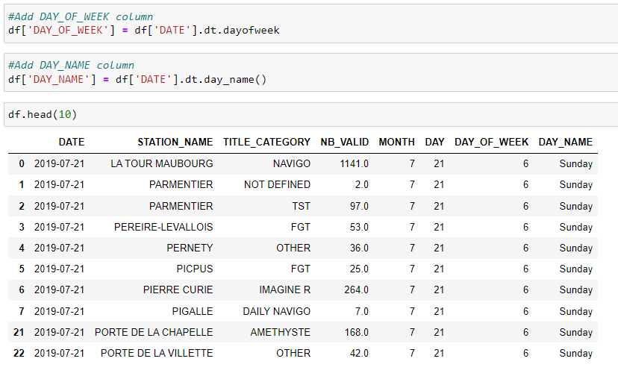
Extract two columns from day column (DAY_OF_WEEK/DAY_NAME)

Slide 23
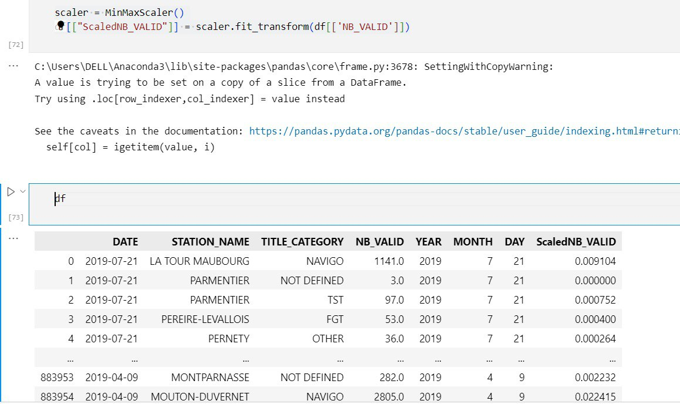
Data scaling
We used MinMaxScaler to apply scaling on NB_VALID column

Slide 24
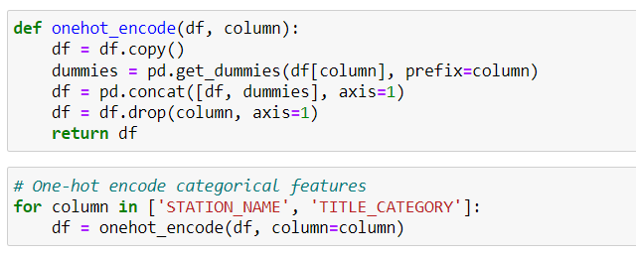
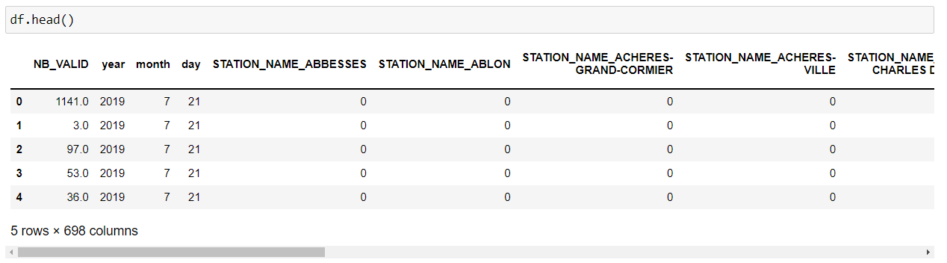
Working with categorical data
Final data

Slide 25
THANKS

